Slide 1
Process Groups: Case Study
Chapter 3
Information Technology Project Management, Seventh Edition

Slide 2
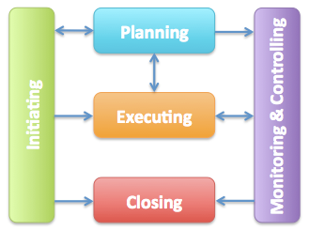
Project Management Process Groups
Project management process groups include
initiating processes
planning processes
executing processes
monitoring and controlling processes
closing processes
https://www.projectconnections.com/templates/pmbok/process-group/

Slide 3
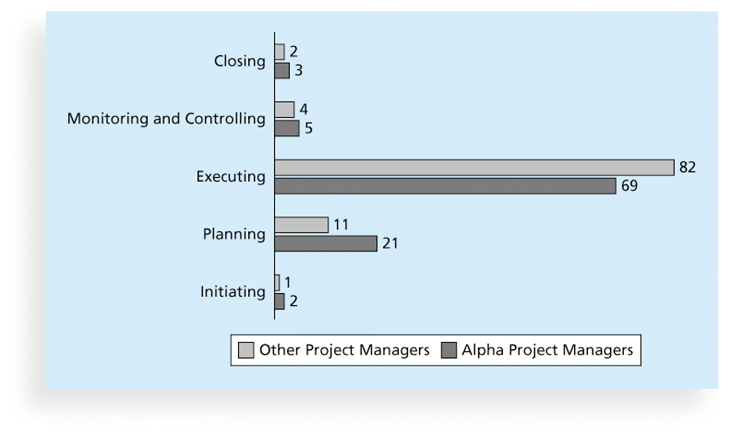
Percentage of Time Spent on Each Process Group

Slide 4
IRS and PM Process
Philip A. Pell, PMP, commented on how the U.S. IRS needed to improve its project management process. “Pure and simple, good, methodology-centric, predictable, and repeatable project management is the SINGLE greatest factor in the success (or in this case failure) of any project… The project manager is ultimately responsible for the success or failure of the project.”*
*Comments posted on CIO Magazine Web site on article “For the IRS, There’s No EZ Fix,” (April 1, 2004).

Slide 5
Process Groups & Knowledge Areas
Process groups vs. knowledge areas
Knowledge areas cross the various process groups including some key distinctions
Planning Process includes all KAs
Emphasis on planning
Integration Management Knowledge Areas crosses all processes

Slide 6
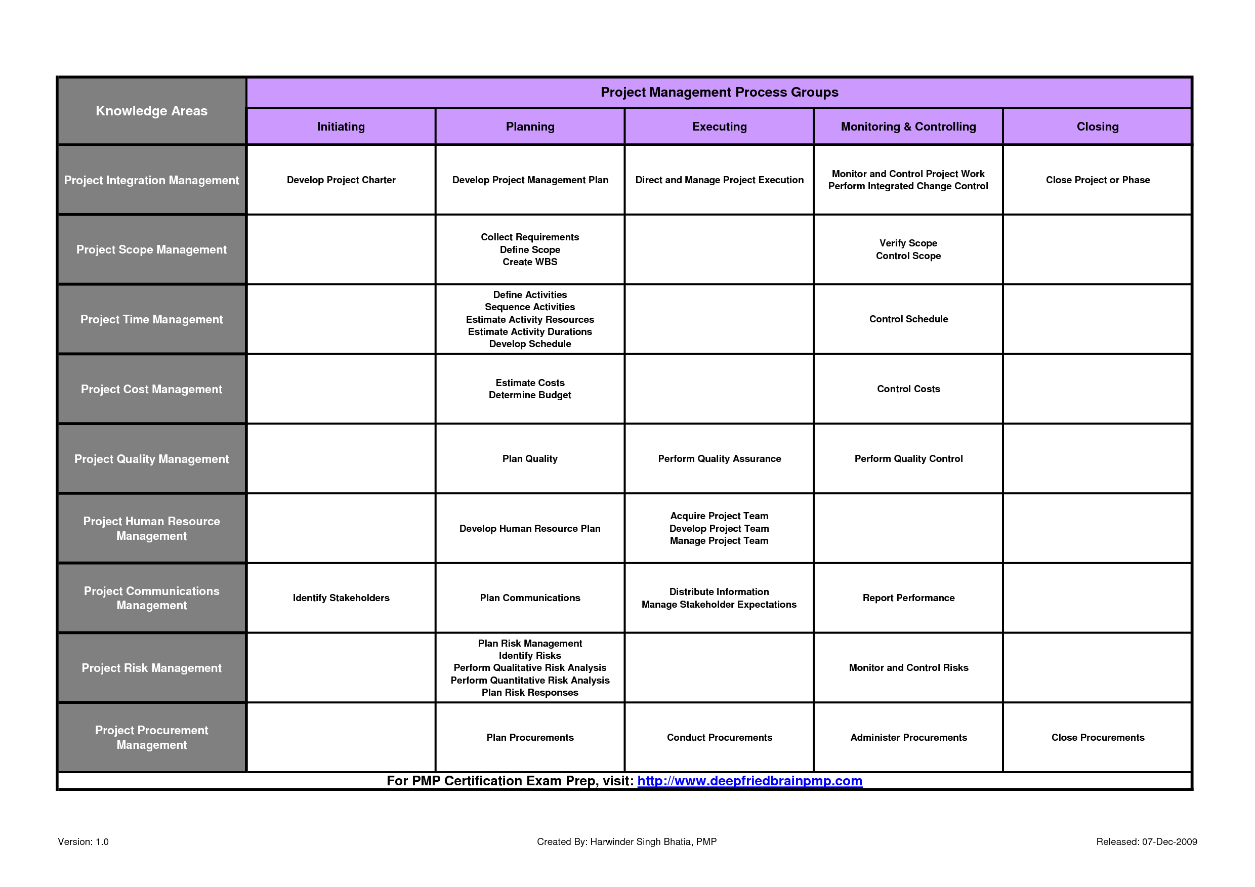
Project Management Process Groups and Knowledge Area Mapping

Slide 7
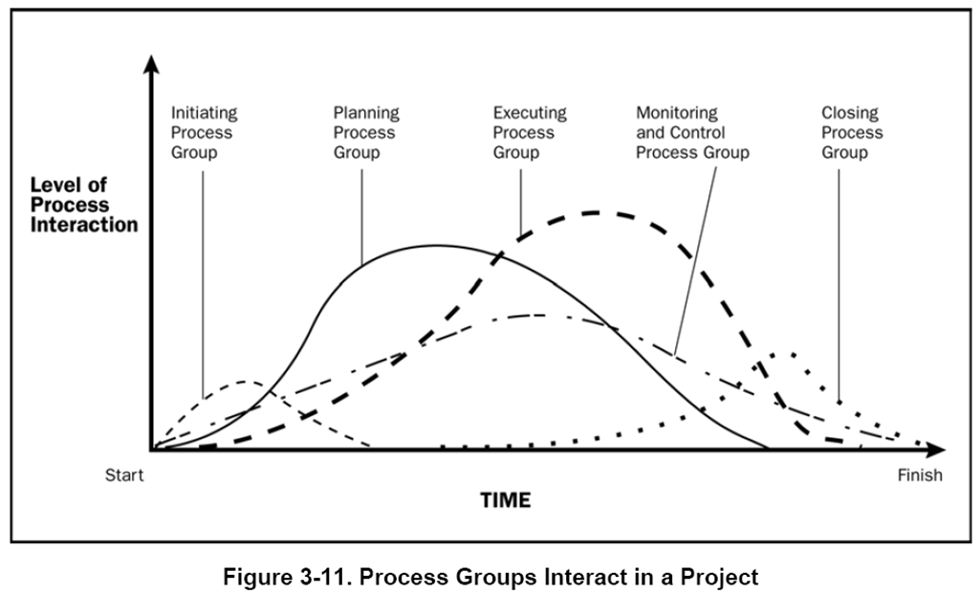
Project Management Process Groups and Knowledge Area Mapping

Slide 8
Developing an IT Project Management Methodology
A methodology describes how things should be done; a standard describes what should be done
Project mgmt methodologies:
PRINCE2
Agile
RUP
Six Sigma

Slide 9
What Went Right?
AgênciaClick, an interactive advertising and online communications company based in São Paulo, Brazil, made PMI’s list of outstanding organizations in project management in 2007
Since 2002, the company saw revenues jump 132 percent, primarily due to their five-year emphasis on practicing good project management across the entire company

Slide 10
Case Study: JWD Consulting’s Project Management Intranet Site
Case Background
PM, Sponsor, Stakeholders
Project Description

Slide 11
Project Pre-initiation
Senior managers often perform several pre-initiation tasks, including the following:
Determine the scope, time, and cost constraints for the project
Identify the project sponsor
Select the project manager
Develop a business case for a project
Meet with the project manager to review the process and expectations for managing the project
Determine if the project should be divided into two or more smaller projects

Slide 12
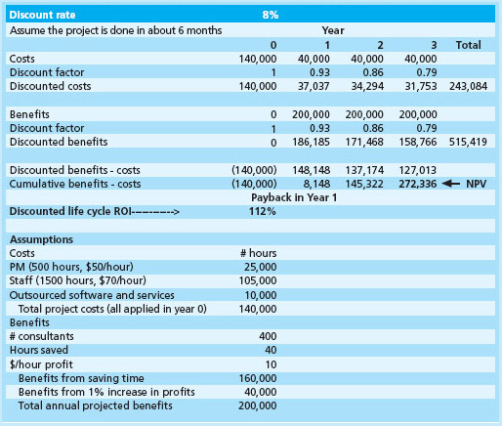
JWD Pre-initiation
What did JWD do for Pre-Initiation?

Slide 13

Project Initiation
Initiating a project includes recognizing and starting a new project or project phase

Slide 14
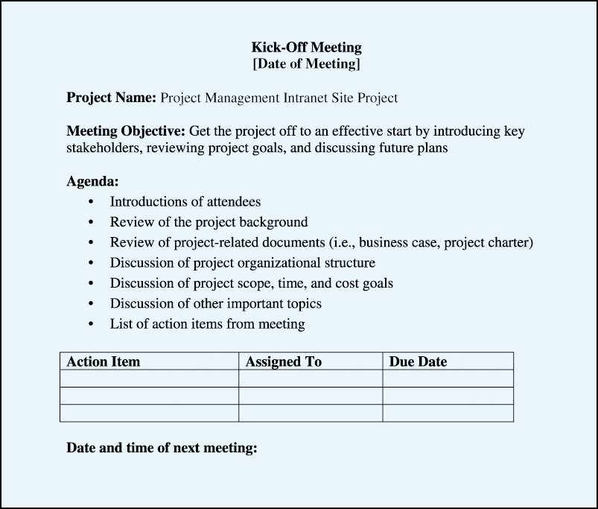
JWD Project Charters and Kick-off Meetings
Charters are normally short and include key project information and stakeholder signatures
Kick-Off Meeting

Slide 15
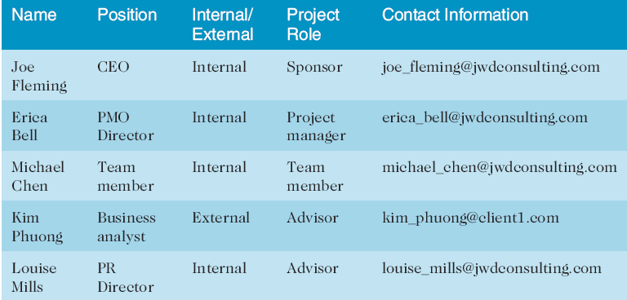
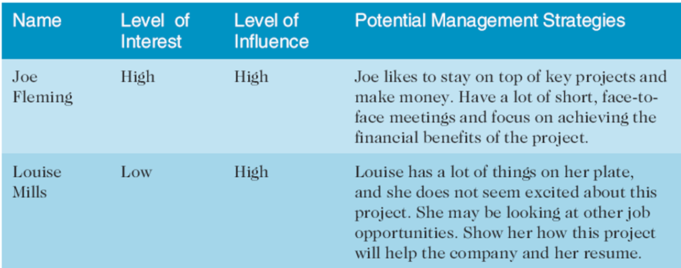
JWD Stakeholder Mgmt Output: Register and Strategy
Register
Management Strategy

Slide 16
Project Planning
Primary Purpose: Guide Execution
Every knowledge area includes planning information
Key outputs included in the JWD project.
Document Location
PM Software
Wiki

Slide 17
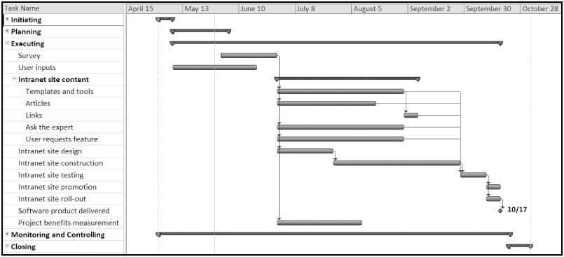
Figure 3-4. JWD Consulting Intranet Site Project Baseline Gantt Chart

Slide 18
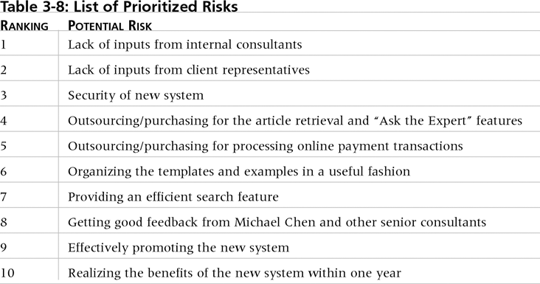
List of Prioritized Risks

Slide 19
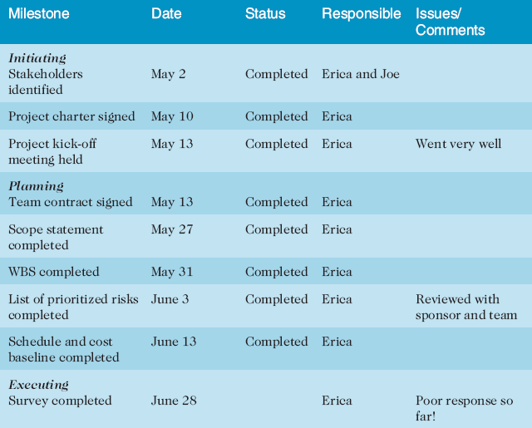
Project Executing
Usually takes the most time and resources
JWD Milestone Report

Slide 20
Project Monitoring and Controlling
Involves measuring progress toward project objectives, monitoring deviation from the plan, and taking correction actions

Slide 21
Project Closing
Involves gaining stakeholder and customer acceptance of the final products and services

Slide 22
Best Practice
Examine PMI’s Project of the Year award
The Quartier international de Montreal (QIM), Montreal’s international district, was a 66-acre urban revitalization project in the heart of downtown Montreal
This $90 million, five-year project turned a once unpopular area into a thriving section of the city with a booming real estate market and has generated $770 million in related construction

Slide 23
Discussion
What are some of the typical challenges project teams face during each of the five process groups?
Why do organizations need to tailor project management concepts, such as those found in the PMBOK® Guide, to create their own methodologies?

